Slide 1



Calculating the Zeeman effect beyond first order in ³He⁺
An Investigation of The Higher Order Zeeman Effect
Evan M.R. Petrimoulx
University of Windsor
University of Windsor Physics with Thesis Defence

Slide 2
Table of Contents
Motivation and Significance
The Zeeman Effect
Perturbation Theory
Recursion Relations r²
Recursion Relations 1/r
Double Perturbation Theory
Dalgarno Interchange Theorem
Relativistic Corrections
Results
Future Work
U. Windsor Undergraduate Seminar
Calculating the Zeeman effect beyond first order in ³He | Evan M.R. Petrimoulx, University of Windsor

Slide 3
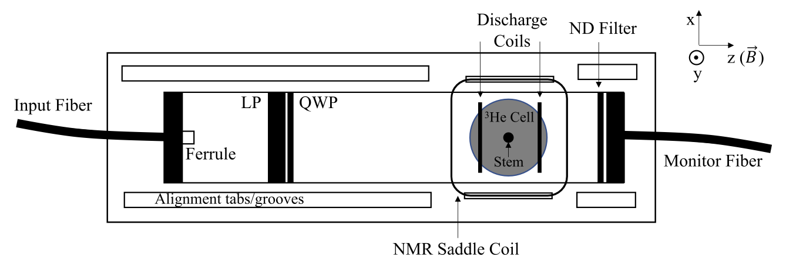
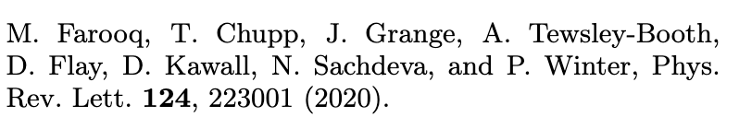
Motivation for the project
Magnetometer at Ann Arbor
- Max Planck Heidelberg group
- Researchers in Ann Arbor, Michigan have constructed a magnetometer with ³He and used it for absolute calibration comparisons to two water-NMR magnetometers at 1.45 T.
Are any corrections to the linearity of the two-state splitting due to some kind of mixing of higher order terms in the Zeeman effect? My work will provide insight on these effects and allow for further development of more precise measuring equipment.
The effect is electronic, not nuclear. The nuclear effect is suppressed by a factor of
- Klaus Blaum's Max Planck Heidelberg group is conducting an experiment on a self-calibrated measurement of the helion magnetic moment. They are using a ³He⁺ magnetometer to make their measurements. Our work along with the work at Ann Arbor, Michigan will help them tune their equipment and aid in the search of new physics!
Calculating the Zeeman effect beyond first order in ³He | Evan M.R. Petrimoulx, University of Windsor

Slide 4
What is the Zeeman effect?
When an atom is placed into an external magnetic field, its energy levels are shifted. The shifting of these Energy levels in known as the Zeeman effect and is dictated by the magnetic quantum number.
The effect can be derived using the canonical momentum
Where is the new term that accounts for the momentum from an external magnetic field.
The canonical momentum can be translated into its quantum mechanical operator analogue and used in the Hamiltonian to show the energy splitting from the Zeeman effect.
Calculating the Zeeman effect beyond first order in ³He | Evan M.R. Petrimoulx, University of Windsor
Notes:
HYLLERAAS IS ONLY FOR 2-3 BODY PROBLEMS

Slide 5
What is the Zeeman effect?
Expanding the expression leads to a 3 term Hamiltonian
The quadratic Zeeman effect
Part of the linear Zeeman effect
Calculating the Zeeman effect beyond first order in ³He | Evan M.R. Petrimoulx, University of Windsor
Notes:
HYLLERAAS IS ONLY FOR 2-3 BODY PROBLEMS

Slide 6
Not the whole story:
There is one more effect which scales proportional to the magnetic field strength that contributes to the overall linear Zeeman effect. The Spin interaction
Combining this with the previously derived Hamiltonian and using , the linear Zeeman effect is
Which has solutions dependent on the magnetic quantum number
Calculating the Zeeman effect beyond first order in ³He | Evan M.R. Petrimoulx, University of Windsor
Notes:
HYLLERAAS IS ONLY FOR 2-3 BODY PROBLEMS

Slide 7
Applications to Magnetometry
Magnetometry deals with the measurement of magnetic fields. It has applications in
Archaeology
Geophysics
Medical Imaging (MRI)
Magnetometers assume a linear relationship between the magnetic field strength and frequency difference between split spectral lines.
The linear relationship is used in practice for important equations such as the Larmor equation, which is especially important in MRI.
Many high-precision magnetometers assume a linear relationship between frequency and magnetic field, which means that all corrections discussed in this work serve as methods of eliminating sources of uncertainty from high-precision measurements!
Calculating the Zeeman effect beyond first order in ³He | Evan M.R. Petrimoulx, University of Windsor
Notes:
HYLLERAAS IS ONLY FOR 2-3 BODY PROBLEMS

Slide 8
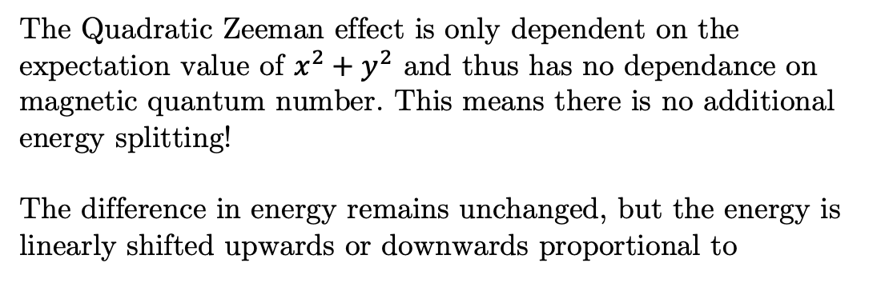
What about the quadratic Zeeman effect?
The Quadratic Zeeman effect is only dependent on the expectation value of $x^{2}+y^{2}$ and thus has no dependance on magnetic quantum number. This means there is no additional energy splitting!
The difference in energy remains unchanged, but the energy is linearly shifted upwards or downwards proportional to
The effect is still significant and plays a role in the higher order effects discussed later.
Calculating the Zeeman effect beyond first order in ³He | Evan M.R. Petrimoulx, University of Windsor
Notes:
HYLLERAAS IS ONLY FOR 2-3 BODY PROBLEMS

Slide 9
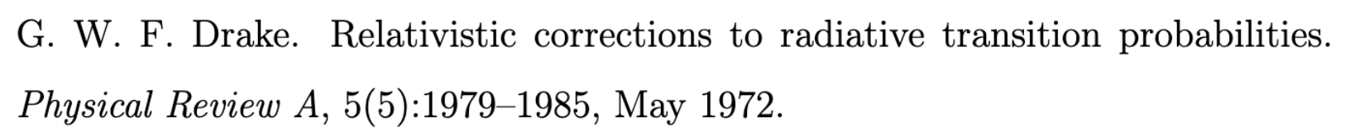
The magnetic dipole moment operator
The magnetic dipole moment operator represents the interaction of a magnetic dipole moment with an external magnetic field. It is described via the following equation:
Where the second term in the brackets accounts for the relativistic correction to the kinetic energy of the electron, and the third term is the potential energy due to the Coulomb interaction between the electron and the nucleus. The first term corresponds to the ordinary Zeeman Effect.
The Bohr magneton.
Relation to magnetic quantum number.
Calculating the Zeeman effect beyond first order in ³He | Evan M.R. Petrimoulx, University of Windsor
Notes:
HYLLERAAS IS ONLY FOR 2-3 BODY PROBLEMS

Slide 10
The magnetic dipole moment operator cont’d
Can be written in terms of the Hamiltonian
The relativistic magnetic dipole moment operator is then written as a perturbation of $\frac{1}{r}$ to the Hamiltonian. We don’t need to perturb about $p^{2}$!
Calculating the Zeeman effect beyond first order in ³He | Evan M.R. Petrimoulx, University of Windsor
Notes:
HYLLERAAS IS ONLY FOR 2-3 BODY PROBLEMS

Slide 11
Including the nuclear Zeeman effect:
The nuclear Zeeman effect behaves similarly to the ordinary electronic effect.
There are also higher order corrections to the nuclear effect as well, but they are a factor of about 5000 times smaller than the electronic effects due to the mass of the nucleus being so much greater than that of the electron.
Nuclear Magneton
Combining everything thus far:
Calculating the Zeeman effect beyond first order in ³He | Evan M.R. Petrimoulx, University of Windsor
Notes:
HYLLERAAS IS ONLY FOR 2-3 BODY PROBLEMS

Slide 12
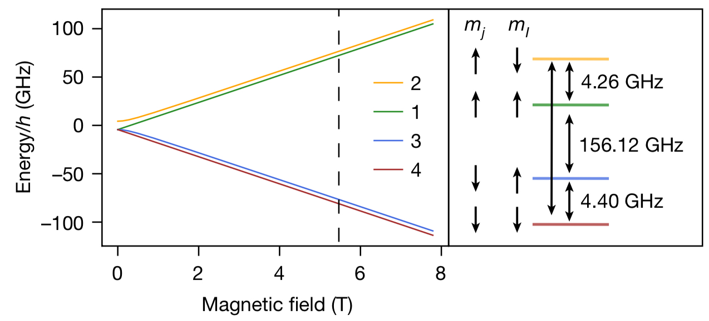
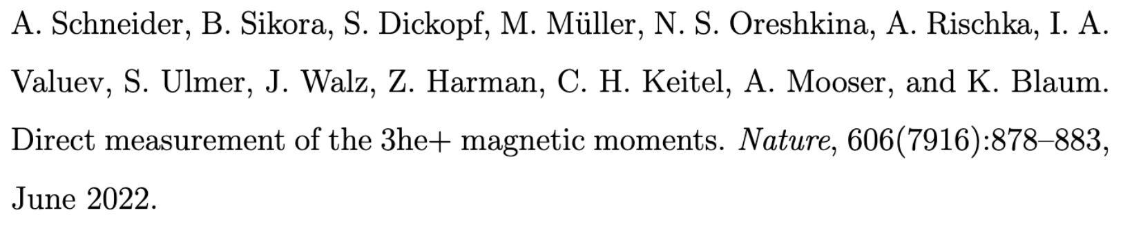
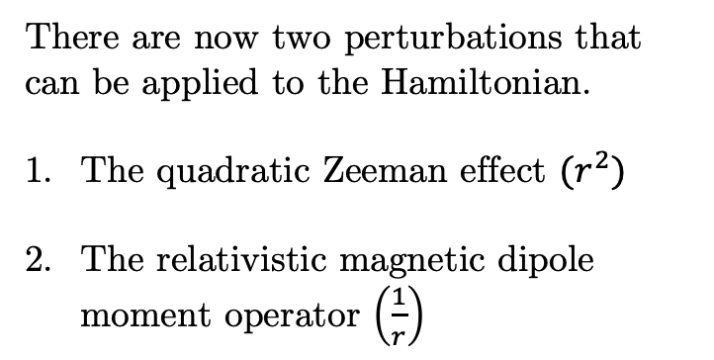
Including the nuclear Zeeman effect cont’d:
There are now two perturbations that can be applied to the Hamiltonian.
The quadratic Zeeman effect $(r^{2})$
The relativistic magnetic dipole moment operator $\left(\frac{1}{r}\right)$
Calculating the Zeeman effect beyond first order in ³He | Evan M.R. Petrimoulx, University of Windsor
Notes:
HYLLERAAS IS ONLY FOR 2-3 BODY PROBLEMS

Slide 13
Perturbation Theory
Starting with the Basic Hamiltonian Equation:
We can expand the wavefunction and its energies as a power series in λ:
And write our total Hamiltonian as the sum of the unperturbed Hamiltonian added with the perturbed term
Combining all 4 equations together we produce the following result:
Calculating the Zeeman effect beyond first order in ³He | Evan M.R. Petrimoulx, University of Windsor
Notes:
HYLLERAAS IS ONLY FOR 2-3 BODY PROBLEMS

Slide 14
Perturbation Theory cont’d
We can rearrange the equation by collecting powers of λ:
Where each power of λ corresponds to a higher order correction. We can then write an equation for each power of λ:
Calculating the Zeeman effect beyond first order in ³He | Evan M.R. Petrimoulx, University of Windsor
Notes:
HYLLERAAS IS ONLY FOR 2-3 BODY PROBLEMS

Slide 15
First-order perturbation theory:
The “First Order” of business is to find . We can do this by multiplying through by
We now have a second order inhomogeneous differential equation to solve to find , and we can use the method
of Frobenius to solve it.
Calculating the Zeeman effect beyond first order in ³He | Evan M.R. Petrimoulx, University of Windsor
Notes:
HYLLERAAS IS ONLY FOR 2-3 BODY PROBLEMS

Slide 16
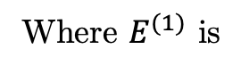
Recursion Relations:
To solve our perturbation equation where we start with:
Which once we differentiate and perform a shift of index for the summations we get:
Where $E^{(1)}$ is
Calculating the Zeeman effect beyond first order in ³He | Evan M.R. Petrimoulx, University of Windsor
Notes:
HYLLERAAS IS ONLY FOR 2-3 BODY PROBLEMS

Slide 17
Recursion Relations:
To solve the equation, we then must solve the recursion relation for a_{j}
The rest of the terms in the series are all equal to zero, since there are no more higher powers of r on the RHS to match the groupings on the LHS. The result is thus:
Calculating the Zeeman effect beyond first order in ³He | Evan M.R. Petrimoulx, University of Windsor
Notes:
HYLLERAAS IS ONLY FOR 2-3 BODY PROBLEMS

Slide 18
Recursion Relations:
Choosing we can solve for the undetermined coefficient
And so is
Calculating the Zeeman effect beyond first order in ³He | Evan M.R. Petrimoulx, University of Windsor
Notes:
HYLLERAAS IS ONLY FOR 2-3 BODY PROBLEMS

Slide 19
Recursion Relations cont’d:
The setup is the same for the $\frac{1}{r}$ perturbation, but with the relativistic magnetic dipole moment operator instead of the quadratic Zeeman operator.
And the first order correction to the energy is
Calculating the Zeeman effect beyond first order in ³He | Evan M.R. Petrimoulx, University of Windsor
Notes:
HYLLERAAS IS ONLY FOR 2-3 BODY PROBLEMS

Slide 20
Recursion Relations cont’d:
So, then we finally have a result for the first order correction to the wave function for a 1/r perturbation:
Calculating the Zeeman effect beyond first order in ³He | Evan M.R. Petrimoulx, University of Windsor
Notes:
HYLLERAAS IS ONLY FOR 2-3 BODY PROBLEMS

Slide 21
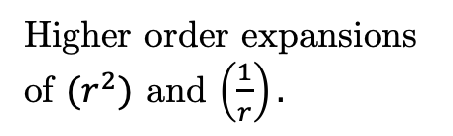
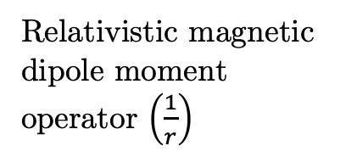
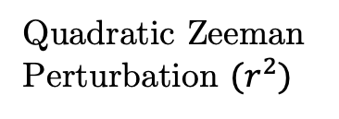
Double perturbation theory
Double perturbation theory is an extension of traditional perturbation theory where instead of a single expansion parameter, we introduce a second!
Remember that the original equation for the Zeeman Hamiltonian involved two perturbation expansion parameters. Up until now they have been treated separately, but can be expressed all at once together using double perturbation theory! Each expansion parameter corresponds to a different expansion parameter.
Expanding we produce:
Higher order expansions of $(r^{2})$ and $\left(\frac{1}{r}\right).$
Quadratic Zeeman Perturbation ${(r}^{2})$
Relativistic magnetic dipole moment operator $\left(\frac{1}{r}\right)$
New Term!
Calculating the Zeeman effect beyond first order in ³He | Evan M.R. Petrimoulx, University of Windsor
Notes:
HYLLERAAS IS ONLY FOR 2-3 BODY PROBLEMS

Slide 22
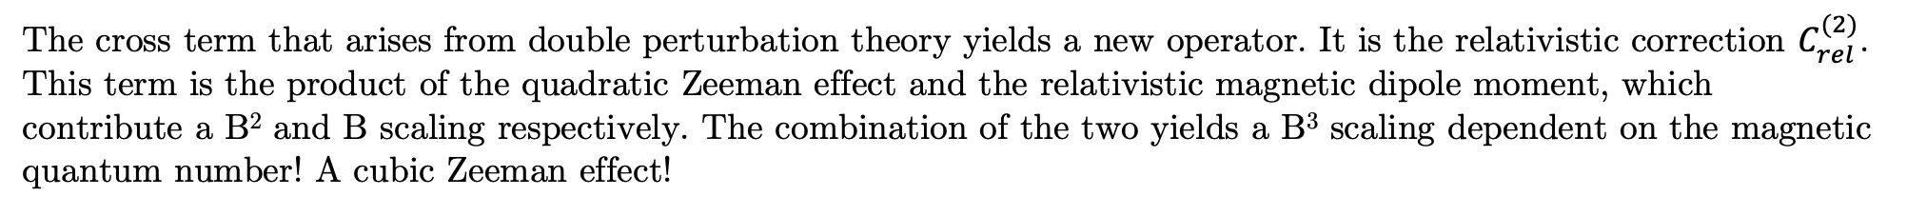
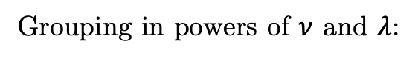
Double perturbation theory cont’d
Grouping in powers of $ν$ and $λ$:
Ordinary Schrödinger Equation
Quadratic Zeeman perturbation
Relativistic magnetic dipole moment operator
New operator
The cross term that arises from double perturbation theory yields a new operator. It is the relativistic correction $C_{rel}^{(2)}$.
This term is the product of the quadratic Zeeman effect and the relativistic magnetic dipole moment, which contribute a B² and B scaling respectively. The combination of the two yields a B³ scaling dependent on the magnetic quantum number! A cubic Zeeman effect!
Calculating the Zeeman effect beyond first order in ³He | Evan M.R. Petrimoulx, University of Windsor
Notes:
HYLLERAAS IS ONLY FOR 2-3 BODY PROBLEMS

Slide 23
Double perturbation theory cont’d
Multiplying equation (4) by $ψ_{0,0}$ and integrating, we obtain the following equation:
So the cubic Zeeman effect can be written as the sum of the two aforementioned perturbations
Calculating the Zeeman effect beyond first order in ³He | Evan M.R. Petrimoulx, University of Windsor
Notes:
HYLLERAAS IS ONLY FOR 2-3 BODY PROBLEMS

Slide 24
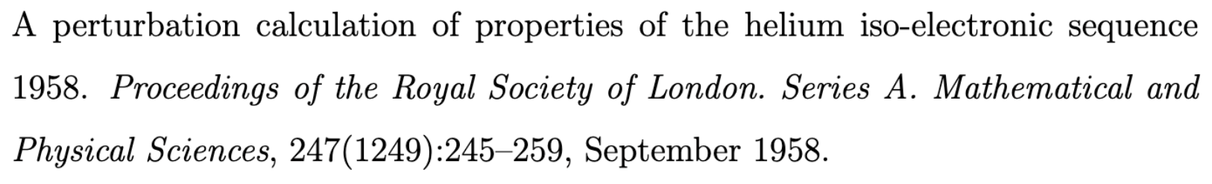
The Dalgarno interchange theorem:
Both terms on the RHS of the above equation can be written in spectral representation to find:
This serves as a critical check for my calculation!
Calculating the Zeeman effect beyond first order in ³He | Evan M.R. Petrimoulx, University of Windsor
Notes:
HYLLERAAS IS ONLY FOR 2-3 BODY PROBLEMS

Slide 25
Relativistic Corrections:
Starting with the expression given from double perturbation theory and the Dalgarno interchange theorem:
Where $γ^{2}≡\frac{B^{2}e^{2}}{m}$ expanding the expression the final result is:
B³ scaling dependent on the magnetic quantum number m_{s}!
Calculating the Zeeman effect beyond first order in ³He | Evan M.R. Petrimoulx, University of Windsor
Notes:
HYLLERAAS IS ONLY FOR 2-3 BODY PROBLEMS

Slide 26
Result Verification:
And similarly to the last expression, we get the same result!
The Dalgarno interchange theorem has verified that the calculation is correct!
Calculating the Zeeman effect beyond first order in ³He | Evan M.R. Petrimoulx, University of Windsor
Notes:
HYLLERAAS IS ONLY FOR 2-3 BODY PROBLEMS

Slide 27
Analysis of Results:
Calculating the Zeeman effect beyond first order in ³He | Evan M.R. Petrimoulx, University of Windsor
Notes:
HYLLERAAS IS ONLY FOR 2-3 BODY PROBLEMS

Slide 28
Analysis of Results:
Calculating the Zeeman effect beyond first order in ³He | Evan M.R. Petrimoulx, University of Windsor
Notes:
HYLLERAAS IS ONLY FOR 2-3 BODY PROBLEMS

Slide 29
Impact:
Calculating the Zeeman effect beyond first order in ³He | Evan M.R. Petrimoulx, University of Windsor
Notes:
HYLLERAAS IS ONLY FOR 2-3 BODY PROBLEMS

Slide 30
Future Work:
Extend to Higher Order Programmatically, including higher angular momentum transitions.
Investigate what happens at higher field strength, such as astrophysical objects.
Calculating the Zeeman effect beyond first order in ³He | Evan M.R. Petrimoulx, University of Windsor
Notes:
HYLLERAAS IS ONLY FOR 2-3 BODY PROBLEMS

Slide 31

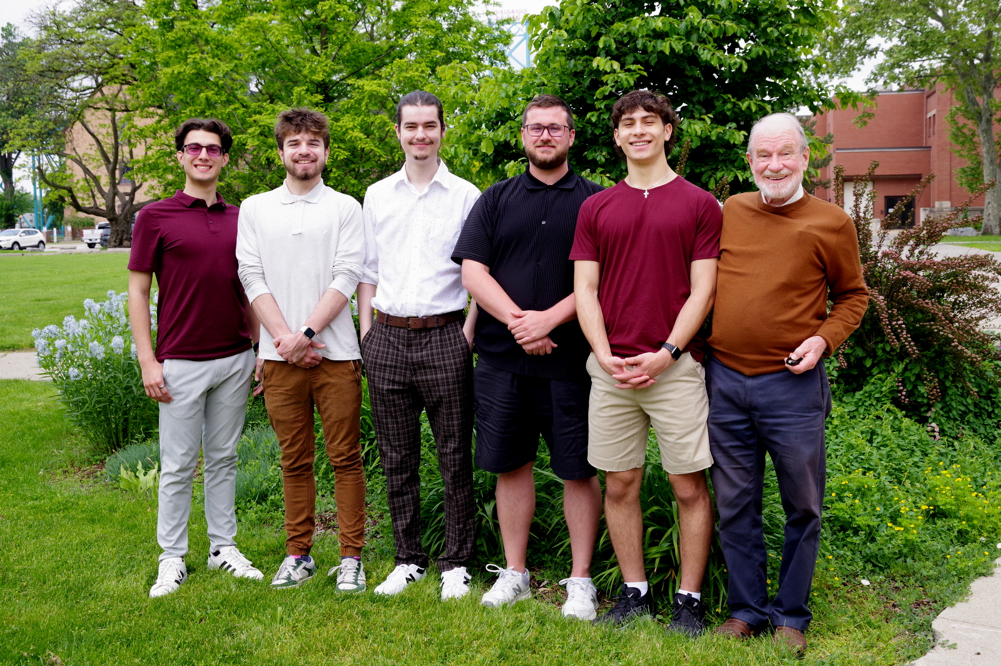

Concluding Remarks
Our files are now publicly available on GitHub!
https://github.com/Drake-Research-Group/dpol_public.git
Photo credit Prof. Gordon Drake
Calculating the Zeeman effect beyond first order in ³He | Evan M.R. Petrimoulx, University of Windsor

